Slide 1
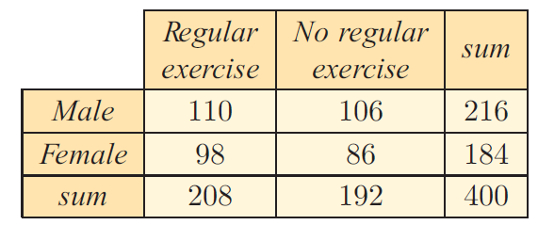
Consider this table:
The Χ² Test of Independence
How many people are in the sample?
How many males?
How many females?
This is called a 2 x 2 contingency table.

Slide 2
Gender vs. Regular Exercise
How are gender and regular exercise related?

Slide 3
Gender vs. Regular Exercise
The variables may be dependent:
Females may be more likely to exercise regularly than males.
The variables may be independent:
Gender has no effect on whether they exercise regularly.
A chi-squared test is used to determine whether two variables from the same sample are independent.

Slide 4
Contingency Tables
Observed Frequencies
Expected Frequencies
 | Column1 | Column2 | Totals
Row1 | a | b | sum row1
Row2 | c | d | sum row2
Totals | Sum column1 | Sum column2 | total
 | Column1 | Column2 | Totals
Row1 |  |  | sum row1
Row2 |  |  | sum row2
Totals | sum column 1 | sum column 2 | total

Slide 5
Χ² Statistic
Calculating Χ²: To test whether gender and regular exercise are independent, we first consider only the sum values of the contingency table. We then calculate the values we would expect to obtain if the variables were independent.

Slide 6
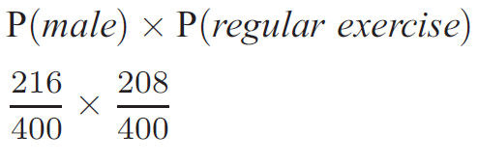
Χ² Statistic
If gender and exercise were independent, then
So, in the sample of 400 adults, we would except

Slide 7
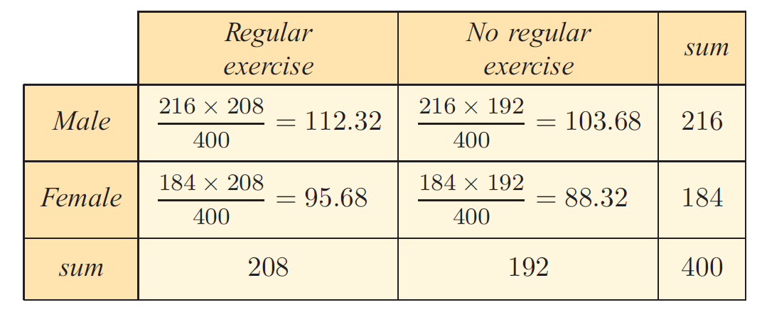
We can perform similar calculations for each cell to complete an expected frequency table.
The Χ² test examines the difference between the observed values we obtained from our sample, and the expected values we have calculated.

Slide 8
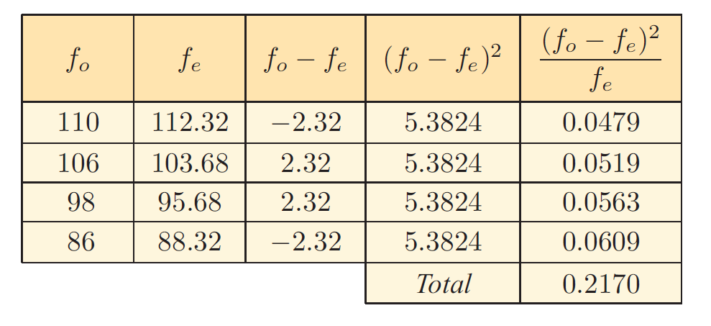
If the variables are independent, the observed and expected values will be similar. This means the value of ( f₀ – f_{e} ) will be small, and hence Χ²_{calc} will be small.
If the variables are not independent, the observed will differ greatly from the expected values. This means the value of ( f₀ – f_{e} ) will be large, and hence Χ²_{calc} will be large.

Slide 9
Χ² Statistic
On TI-84
Put observed data in Matrix A
Stat> Tests > C: χ²-Test
Calculate

Slide 11
Χ² Statistic
On TI-84
Put observed data in Matrix A
Stat> Tests > C: χ²-Test
Calculate
Output:
Χ² → Χ² calculated value
df → degrees of freedom
in Matrix B → expected values

Slide 12
Formula Test:
Write the null hypothesis (H₀)and the alternate hypothesis (H₁).
Create contingency tables for observed and expected values.
Calculate the chi-square statistic and degrees of freedom.
Find the chi-squared critical value (booklet).
Depends on the level of significance (p) and the degrees of freedom (v).
Determine whether or not to accept the null hypothesis.

Slide 13
1. Null and Alternate Hypothesis
H₀: ________ is independent of ________
H₁: ________ is dependent on ________

Slide 14
2&3. Χ² Statistic
On TI-84
Put observed data in Matrix A
Stat> Tests > C: χ²-Test
Calculate
Output:
Χ² → Χ² calculated value
df → degrees of freedom
in Matrix B → expected values

Slide 15
4. Find the Critical Value
Get this from the formula booklet.
Significance level (p) is always given in the problem.
A 5% significance level = 95% confidence level
Degrees of freedom: df = (c - 1)(r – 1)
where c = number of columns in table
and r = number of rows in table

Slide 16
Gender vs. Regular Exercise
The variables may be dependent:
Females may be more likely to exercise regularly than males.
The variables may be independent:
Gender has no effect on whether they exercise regularly.
A chi-squared test is used to determine whether two variables from the same sample are independent.

Slide 17
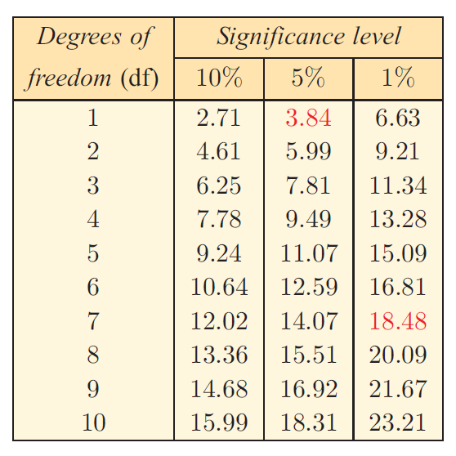
4. Find the Critical Value

Slide 18
5. Accept Null Hypothesis?
If X²_{calc}< Critical Value
ACCEPT the null hypothesis
If X²_{calc}> Critical Value
REJECT the null hypothesis
Can this be determined from the p-value?
Notes:
Hoffman’s train of thought:
Rejection is bad
Want calc value to be smaller than booklet value
(the calculator is physically smaller than the booklet)

Slide 19
On the calculator:
Put your contingency table in matrix A
STAT
TESTS
C: χ² Test
Observed: [A]
Expected: [B] (this is where you want to go)
Calculate

Slide 21
