Slide 1
Unit 3 – Two Variable Statistics
Sections 1:
Correlation and Linear Regression

Slide 2
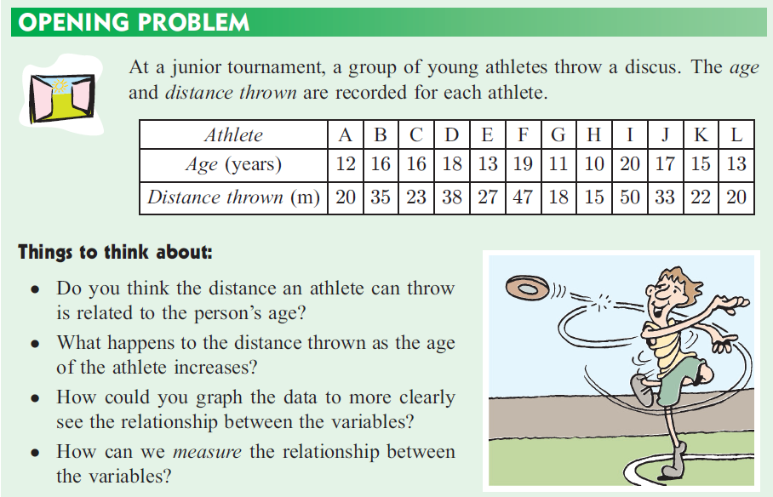
At a tournament, athletes throw a discus. The age and distance thrown are recorded for each athlete:
Correlation
Do you think the distance an athlete can throw is related to the person’s age?
What happens to the distance thrown as the age of the athlete increases?

Slide 3
At a tournament, athletes throw a discus. The age and distance thrown are recorded for each athlete:
How could you graph the data to more clearly see the relationship between the variables?
How can we measure the relationship between the variables?

Slide 4
Vocabulary
Bivariate data – data with two variables.
Scatter plot – a graph that shows the relationship between two variables.
Correlation – the relationship or association between two variables.

Slide 5
The discus throwing data:
Be sure to put the:
  independent variable along the horizontal and the
  dependent variable along the vertical axis.

Slide 6
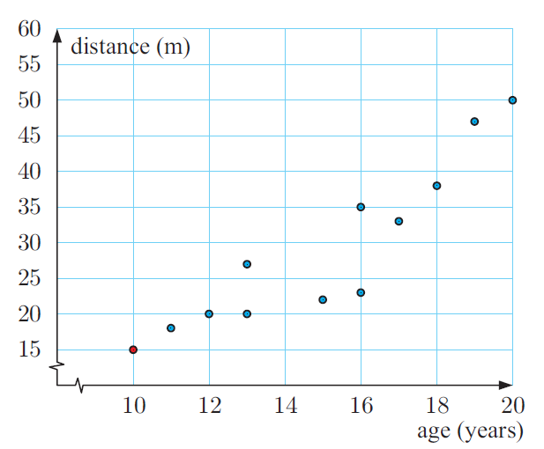
A scatterplot of the discus throwing data:

Slide 7
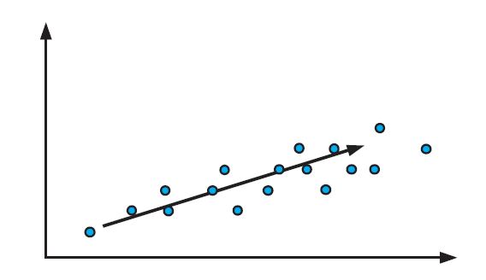
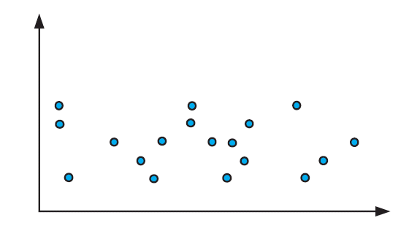
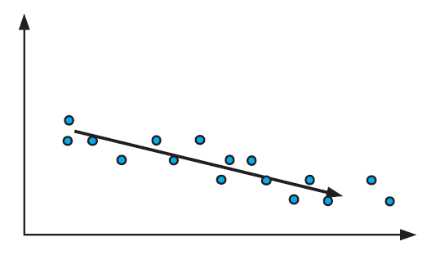
Finding Correlation:
Look for a direction
positive correlation
negative correlation
no correlation

Slide 8
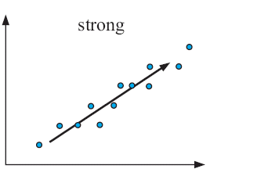
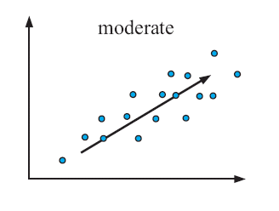
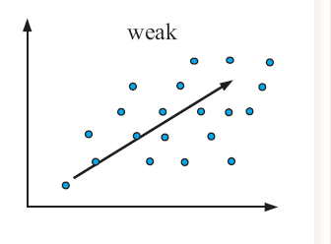
Finding Correlation:
Describe the Strength

Slide 9
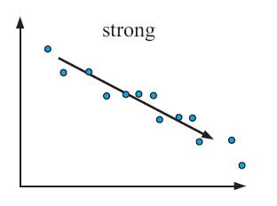
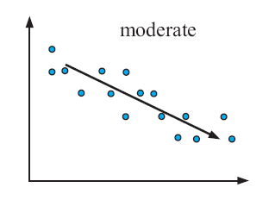
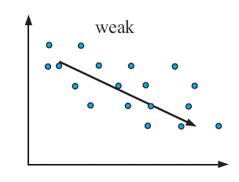
Finding Correlation:
Describe the Strength

Slide 10
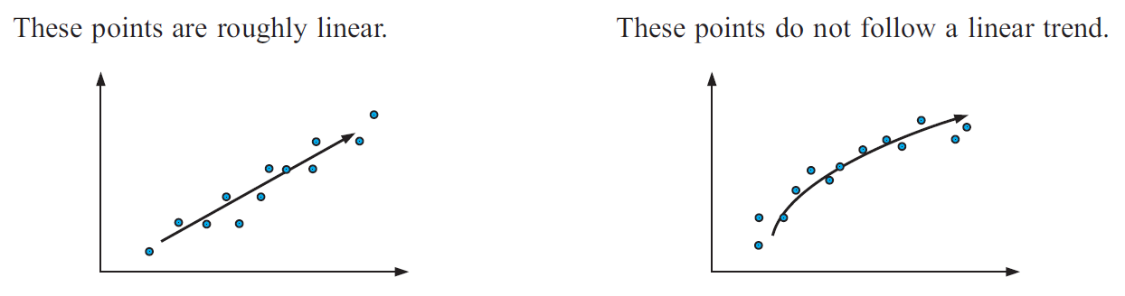
Finding Correlation:
Determine if the Trend is Linear
These points do not follow a linear trend.

Slide 11
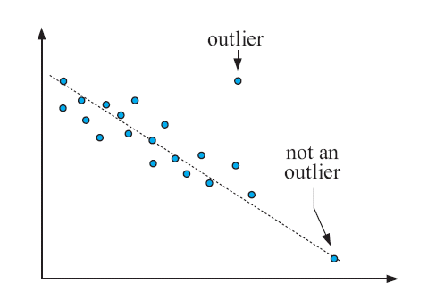
Finding Correlation:
Observe and Investigate Outliers

Slide 12
Scatterplots
TI-84 and Autograph
Age (years) | Distance thrown (m)
12 | 20
16 | 35
16 | 23
18 | 38
13 | 27
19 | 47
11 | 18
10 | 15
20 | 50
17 | 33
15 | 22
13 | 20

Slide 13
Correlation Coefficient
Measuring Correlation
To measure correlation use:
  the Pearson’s product-moment correlation coefficient, r.
-1 ≤ r ≤ 1
The closer to ±1, the stronger the relationship.
  If r = 0, there is no linear relationship
  If r = 1, there is a perfect linear relationship

Slide 14
FORMULA
Pearson’s Correlation Coefficient: r
IB Note:
For the EXAM students do NOT need to know how to find the covariance.
But, for their project if they’re doing regression, then they DO need to do covariance by hand so they can do the r by hand so they can get points for using a sophisticated math process.

Slide 15
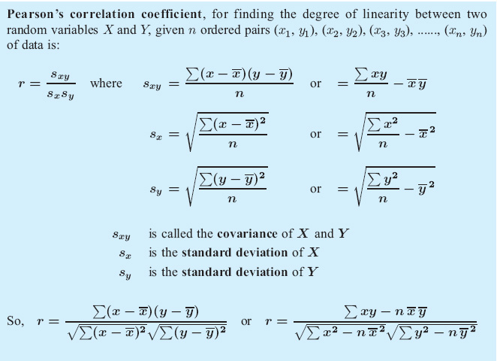
FORMULA
Pearson’s Correlation Coefficient: r

Slide 16
Definition:
Covariance is a measure of how much two variables change together.

Slide 17
From the IB Subject Guide:
In examinations: the value of s_{xy} will be given if required.
s_{x} represents the standard deviation of the variable X;
s_{xy} represents the covariance of the variables X and Y.
A GDC can be used to calculate r when raw data is given.

Slide 18
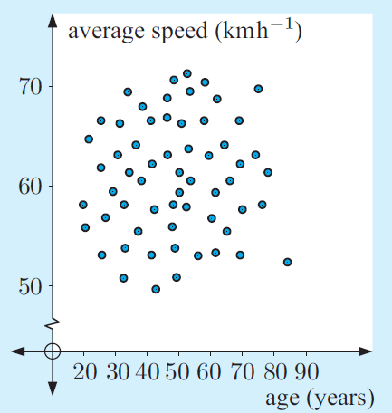
1) Average speed in the metropolitan area and age of drivers
Example 1
The r-value for this association is 0.027. Describe the association.

Slide 19
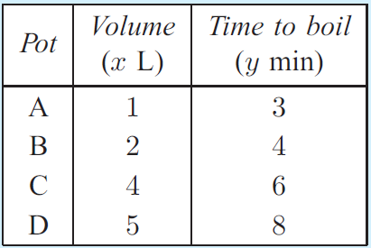
2) Sue investigates how the volume of water in a pot affects how long it takes to boil on the stove. The results are given in the table.
Example 2
Find Pearson’s correlation coefficient between the two variables.
Notes:
Example 2 from page 599 (2nd edition)

Slide 20
Example 3
3) In an experiment a vertical spring was fixed at its upper end. It was stretched by hanging different weights on its lower end. The length of the spring was then measured. The following readings were obtained.
Load (kg) x | 0 | 1 | 2 | 3 | 4 | 5 | 6 | 7 | 8
Length (cm) y | 23.5 | 25 | 26.5 | 27 | 28.5 | 31.5 | 34.5 | 36 | 37.5
(i) Write down the mean value of the load,
(ii) Write down the standard deviation of the load.
(iii) Write down the mean value of the length,
(iv) Write down the standard deviation of the length.
It is given that the covariance S_{xy} is 12.17.
(d) (i) Write down the correlation coefficient, r, for these readings.
(ii) Comment on this result.
Notes:
Nov 2006, paper 2, question 3

Slide 21


Slide 23
Correlation Coefficient on the TI 84
Turn on your Diagnostics
Enter the data in L1 and L2
LinReg L1, L2

Slide 24
4) At a father-son camp, the heights of the fathers and their sons were measured.
Example 4
Draw a scatter plot of the data.
Calculate r
Describe the correlation between the variables.
Notes:
Example 4 on page 602 of 2nd edition

Slide 25
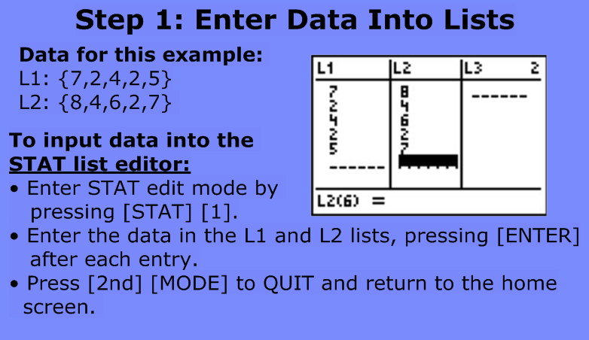

Slide 26
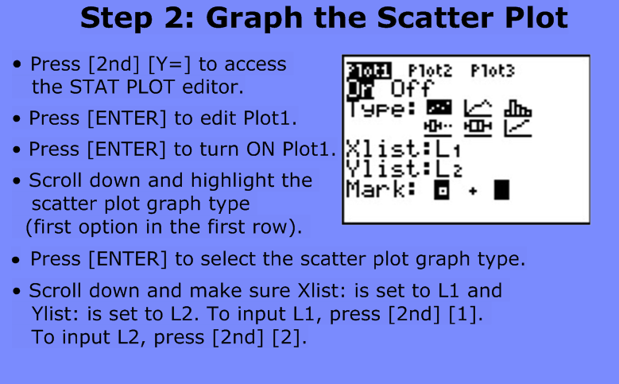

Slide 27
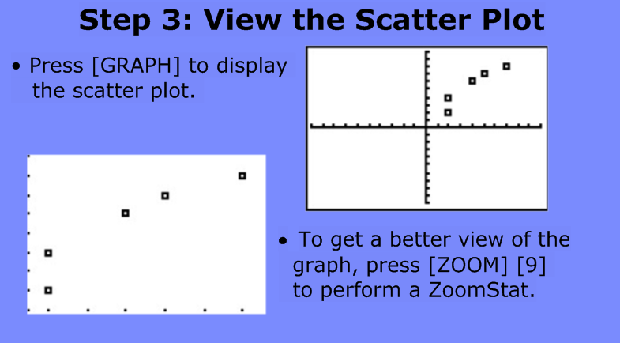

Slide 28
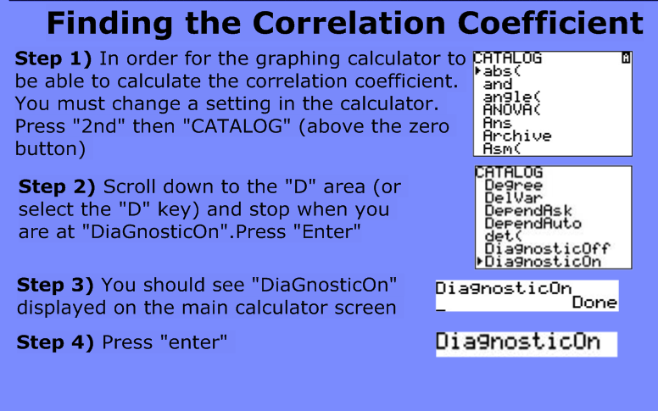

Slide 29
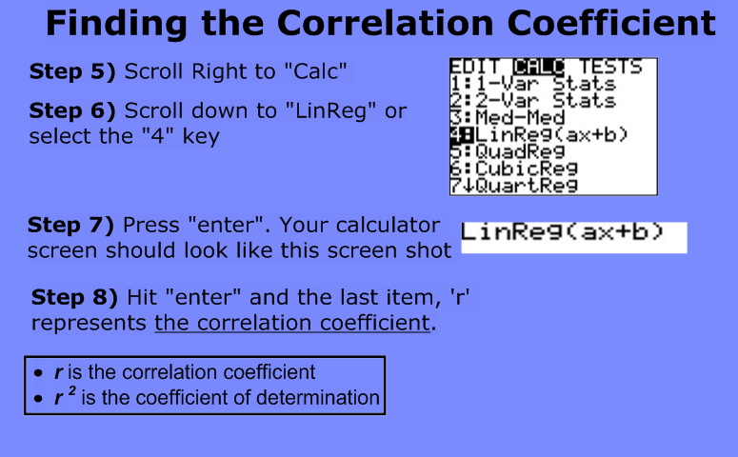

Slide 30
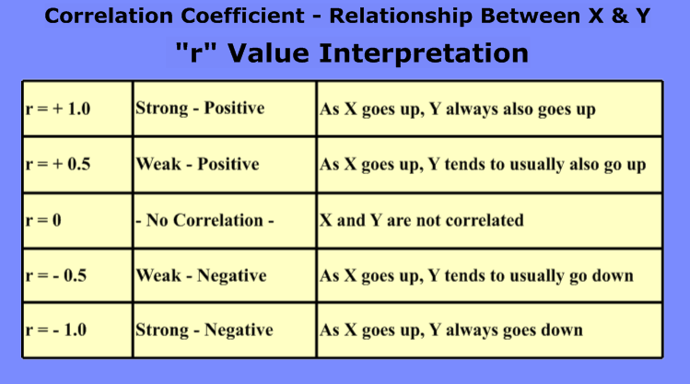

Slide 31
Correlation Coefficient on Autograph
Open a 2D Graph Page
Data > Enter XY Data Set
Enter your data
Select Show Statistics
Click OK
Click Transfer to Results Box
View > Results Box

