Slide 1
IB Math Studies Topic: Functions
Chapters 16-18 of textbook

Slide 2
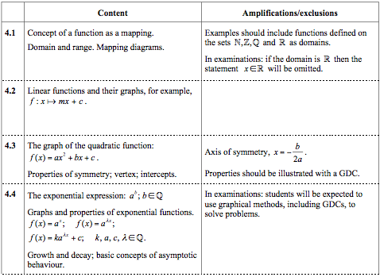
IB Course Guide description

Slide 3
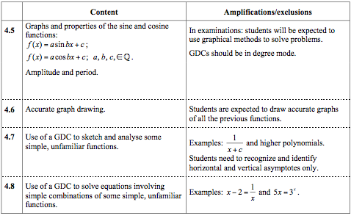

Slide 4
Domain, Range and Function Mapping
Domain: The set of values to be put into a function.
In other words the set of possible x values
Range: The set of values produced by a function.
In other words the set of possible y values

Slide 5
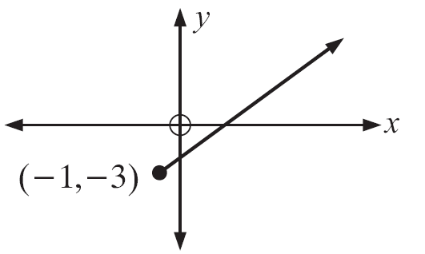
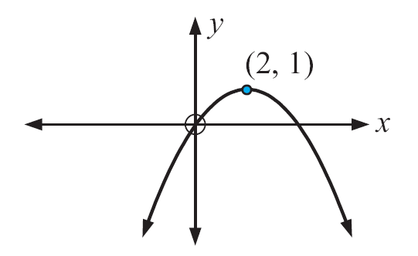
Identify the domain and range of the following functions
a.
b.

Slide 6
Check your answers
Domain: x ≥ -1
Range: y ≥ -3
b. Domain: any real number
Range: y ≤ 1

Slide 7
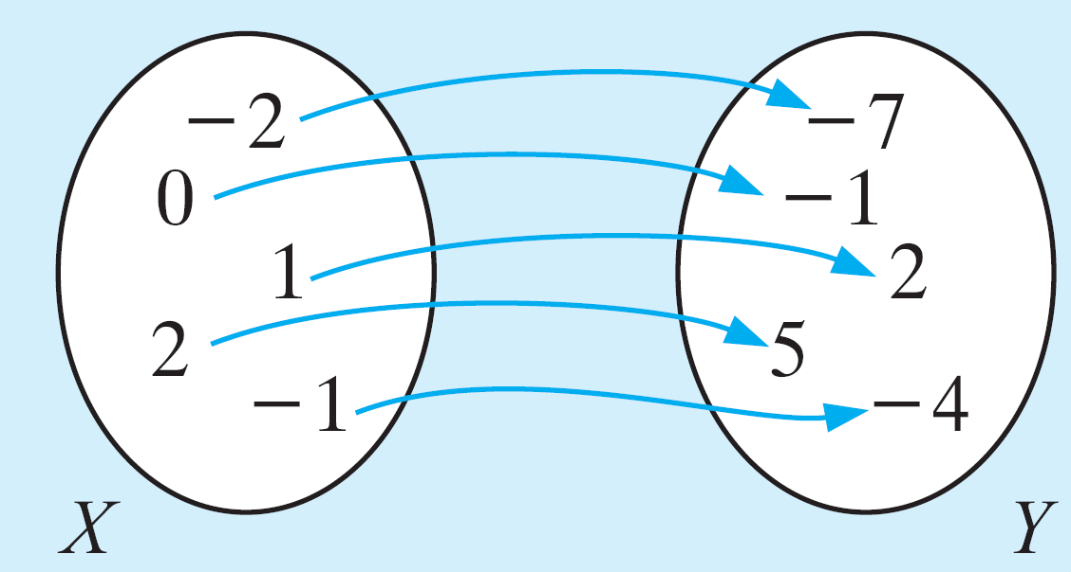
A mapping diagram is a simple way to illustrate how members of the domain are “mapped” onto members of the range
It shows what happens to certain numbers in the domain under a certain function
This mapping for example shows what happens to the domain {-2, 0, 1, 2, -1} under the function f(x) = x²
For a relationship to be a function, each member of the domain can only map on to one member of the range; but it is ok for different members of the domain to map onto the same member of the range

Slide 8
The mapping below is of the form $f\left(x\right)=x²+1$and maps the elements of x to elements of y.
List the elements of the domain of f.
List the elements in the range of f.
Find p and q

Slide 9
Check your answers
Domain: {q, -1, 0, 1, 3}
Range: {5, 2, 1, p}
q=2
p=10

Slide 10
Linear Functions
Always graph a line and are often written in the form of y = mx + b
Where m = slope or gradient
Where b = y-intercept (the point where the line cuts the y axis)
ax + by = c is the rearrangement of this first form

Slide 11
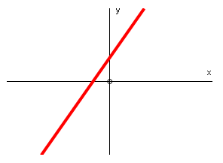
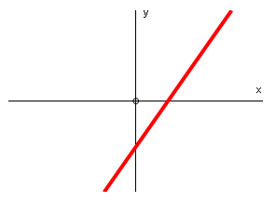
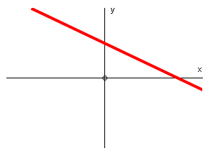
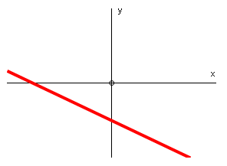
Graphs of a linear function
A line with positive slope and a positive y-intercept
A line with positive slope and a negative y-intercept
A line with negative slope and a positive y-intercept
A line with negative slope and a negative y-intercept

Slide 12
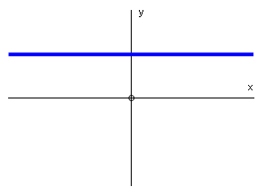
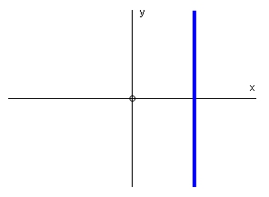
Horizontal line
Vertical line
- Horizontal lines are always in the form y = c or y = k , where c or k are the constant.
- The slope of a horizontal line is zero
- Vertical lines are always in the form x = c or x = k, where c or k are the constant.
- The slope of a vertical line is undefined.

Slide 13
Intersection of lines:
The point where two lines can be worked out algebraically by solving a pair of simultaneous equations
Finding the equation of a line
You need to know its gradient and a point
Can substitute into y = mx + b
Use the formula y - y₁ = m(x - x₁) where (x₁ , y₁) is the point

Slide 14
Example – equation of the line
A line goes through (2,3) and (5,9) – what is its equation
Substitute into y = mx + b
Gradient = $\frac{9−3}{5−2 }$ = 2
So y = 2x + b
Substitute (2,3)
3 = 2(2) + b
b = -1
The equation is y = 2x - 1
Use the formula y - y₁ = m(x - x₁) where (x₁ , y₁) is the point
y - 3 = 2(x -2)
y – 3 = 2x - 4
y = 2x - 1

Slide 15
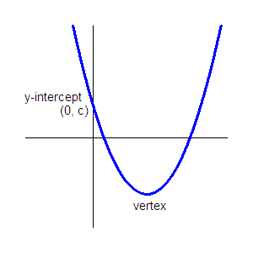
Quadratic Functions
Two different forms
The graph of every quadratic function is a parabola (u-shape)
Standard form | $y=ax$² $+bx+c$ | Vertex: ($\frac{−b}{2a}, f(\frac{−b}{2a}))$
Vertex form | $y=a(x−h)$² $+ k$ | Vertex: (h,k)
X-intercepts:
(zeros, solutions)

Slide 16
To find the solutions (zeros/x-intercepts) by hand:
Set the equation equal to zero
Factor
Solve
You will have two solutions
To find the solutions in the calculator:
Type the equation in Y=
Calculate
2: Zero
The axis of symmetry:

Slide 17
To find vertex by hand:
The equation must be in the form $y=ax$² $+bx+c$
The x-coordinate is equal to
Plug the x-coordinate back into the function, f(x), to get the y-coordinate of the vertex.
To find the vertex in the calculator
Type the equation in Y=
Calculate
3: Minimum (if the parabola opens up) or 4: Maximum (if the parabola opens down)

Slide 18
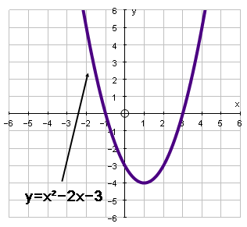
Example
The y-intercept is -3 which is the same as the c-value of the equation.
The x-intercepts (also known as “zeros”) are at -1 and 3.
Halfway between -1 and 3 is the x-coordinate of the vertex; x = 1
If you evaluate y(1) you will get the y-coordinate of the vertex.
y(1) = 1² – 2(1) – 3
y(1) = -4
If you set y = 0, then you can factor the equation and solve for x:
x² – 2x – 3 = 0
(x – 3)(x + 1) = 0
x = 3 and x = -1
These are the x-intercepts.

Slide 19
Quadratic formula
Some quadratic equations do not factor
To solve them use the quadratic formula
This is given to use in the formula sheet the day of the exam

Slide 20
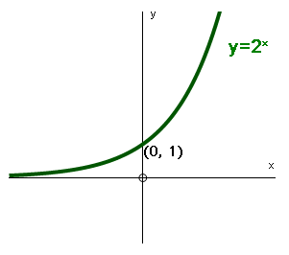
Exponential Functions
Exponential functions are functions where the unknown value, x, is the exponent.
For the “mother function” the following is true:
domain: all real numbers
range: y > 0
y-intercept: (0, 1)
asymptote: y = 0

Slide 21
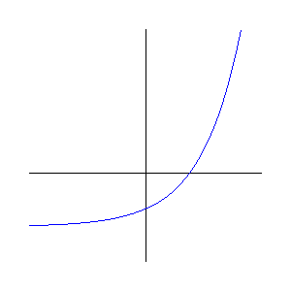
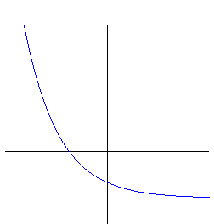
Growth
Decay
y = 2^{-x} – 2
y = 2^{x} – 2
The positive exponent represents growth
The negative exponent represents decay

Slide 22
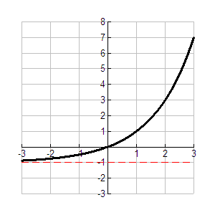
Exponential graphs are asymptotic
They get closer and closer to a line but never reach it
Example: y = 2^{x} – 1
If the equation is in the form y = a^{x} then the asymptote is the x-axis or 0
If the equation is in the form y = a^{x} + c then the asymptote is the x = c
The c in this equation shows the movement upwards or downwards of the graph
In this example the -1 moved the graph down one on the y axis
Asymptote: y = -1

Slide 23
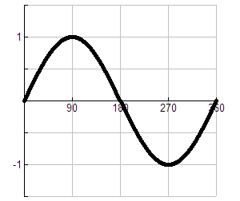
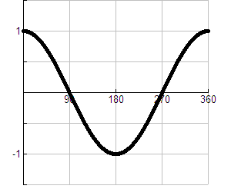
Trigonometric Functions
Sine function | Cosine function
$$f\left(x\right)=a sin{bx+c }$$ | $$f\left(x\right)=a cos{bx+c}$$
a is the amplitude
c is the vertical translation
b is the number of cycles between 0° & 360° and period = $\frac{360°}{b}$
y = sin x
y = cos x

Slide 24
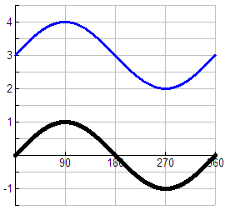
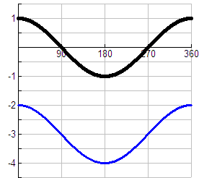
Vertical translation
Adding a number to the function causes the curve to translate up
Subtracting a number from the function causes the curve to translate down
y = (sin x) + 3
y = (cos x) - 3

Slide 25
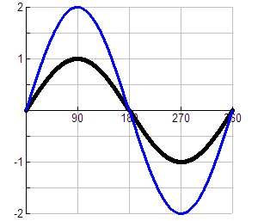
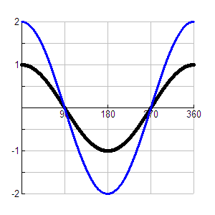
Vertical stretch (changing the amplitude)
Multiplying the function by a number causes the curve to be stretched vertically; in other words, the amplitude has changed. The amplitude is the distance between the principle axis of the function and a maximum (or a minimum).
y = 2sin x
y = 2cos x

Slide 26
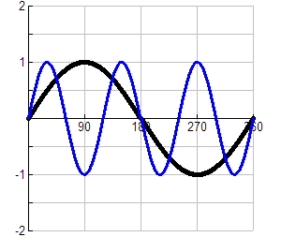
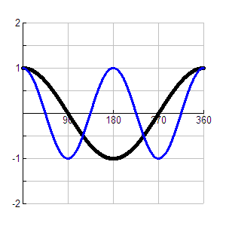
Horizontal stretch (changing the period)
Multiplying x by a number causes the curve to be stretched horizontally
y = sin (3x)
y = cos (2x)

Slide 27
Sketching Functions
Important tips
Use your calculator to help you
Set up the “window” correctly to see the part of the graph that you need
Remember parenthesis
If you are not careful you could type an equation different than the one the test is asking
Label both x and y axes
Include the scale on both axes
Graph function in your calculator first
Use the TABLE to get some point to plot

Slide 28
Using a GDC to solve equations
Type one side of the equation in Y1
Type the other side of the equation in Y2
Calculate – Intersect (option 5)
Remember the rules for sketching functions

