Slide 1
Vector Application Problems
Unit 2 - Vectors

Slide 2
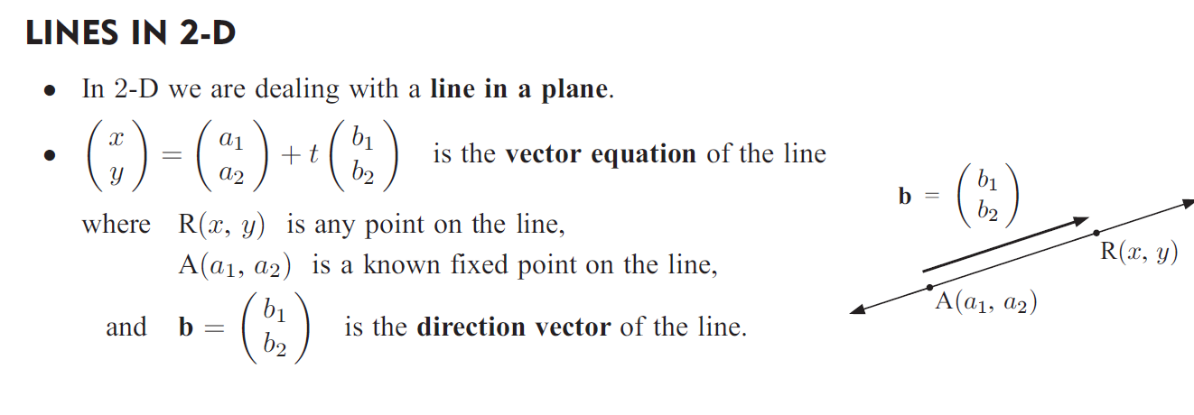
Vector Equations

Slide 3
Example 1
For the line that passes through (-6, 3) with direction , write down the corresponding:
vector equation
parametric equations
Cartesian equation

Slide 4
Similarly, for 3-D Vectors…

Slide 5
Example 2
Find parametric equations of the line through A(2,-1,4) and B(-1,0,2)

Slide 6
Constant Velocity Applications

Slide 7
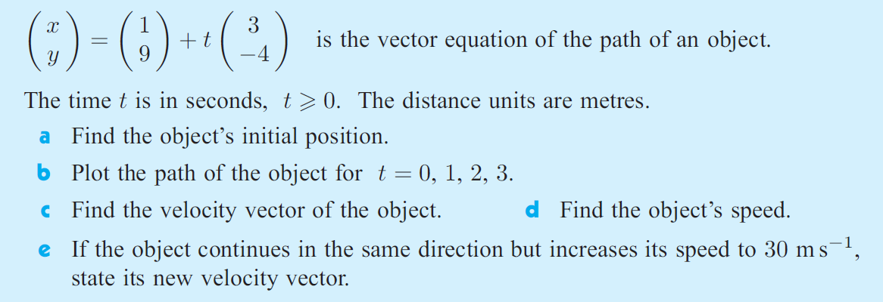
Example 3

Slide 9
Example 4
An object is initially at (5,10) and moves with velocity vector 3i – j metres per minute. Find:
The position of the object at time t minutes (parametric equation)
The speed of the object
The position of the object at t=3 minutes
The time when the object is due east of (0,0).

Slide 10
Example 5
A particle at P(x(t), y(t)) moves such that x(t) = 1 + 2t and y(t) = 2 -5t, t ≥ 0. The distance are in centimetres and t is in seconds.
The initial position of P.
Illustrate the initial part of the motion of P where t = 0,1,2,3
Find the velocity vector of P.
Find the speed of P.

