Slide 1
Summer Packet Review
Algebra 2

Slide 2
In this Presentation, we will review:
Functions
Solving inequalities
Compound Inequalities
Solving Systems of Equations by:
Graphing
Elimination
Substitution

Slide 3
A relation is a set of ordered pairs.
The domain is the set of all x values in the relation
domain = {-1,0,2,4,9}
These are the x values written in a set from smallest to largest
This is a relation
{(2,3), (-1,5), (4,-2), (9,9),
{(2,3), (-1,5), (4,-2), (9,9),
{(2,3), (-1,5), (4,-2), (9,9), (0,-6)}
These are the y values written in a set from smallest to largest
range = {-6,-2,3,5,9}
The range is the set of all y values in the relation

Slide 4
A function f from set A to set B is a rule of correspondence that assigns to each element x in the set A exactly one element y in the set B.
1
2
All x’s are assigned
2
4
3
6
4
8
5
10
Set A is the domain
Set B is the range
This is a function ---it meets our conditions
Must use all the x’s
The x value can only be assigned to one y

Slide 5
Let’s look at another relation and decide if it is a function.
The second condition says each x can have only one y, but it CAN be the same y as another x gets assigned to.
No x has more than one y assigned
1
2
All x’s are assigned
2
4
3
6
4
8
5
10
Set A is the domain
Set B is the range
This is a function ---it meets our conditions
Must use all the x’s
The x value can only be assigned to one y

Slide 6
If a vertical line passes through a graph more than once, the graph is not the graph of a function.
Hint:
Pass a pencil across the graph held vertically to represent a vertical line.
The pencil crosses the graph more than once. This is not a function because there are two y-values for the same x-value.

Slide 12
Function Notation
We commonly call functions by letters. Because function starts with f, it is a commonly used letter to refer to functions.
This means the right hand side is a function called f
The left side DOES NOT MEAN f times x like brackets usually do, it simply tells us what is on the right hand side.
This means the right hand side has the variable x in it
The left hand side of this equation is the function notation. It tells us two things. We called the function f and the variable in the function is x.

Slide 13
Remember---this tells you what is on the right hand side---it is not something you work. It says that the right hand side is the function f and it has x in it.
So we have a function called f that has the variable x in it.
Using function notation we could then ask the following:
This means to find the function f and instead of having an x in it, put a 2 in it. So let’s take the function above and make brackets everywhere the x was and in its place, put in a 2.
Find f (2).
Don’t forget order of operations---powers, then multiplication, finally addition & subtraction

Slide 14
Find f (2k).
This means to find the function f and instead of having an x in it, put a 2k in it. So let’s take the function above and make brackets everywhere the x was and in its place, put in a 2k.
Don’t forget order of operations---powers, then multiplication, finally addition & subtraction

Slide 15
Inequality Symbols
Less than
Not equal to
Less than or equal to
Greater than
Greater than or equal to

Slide 16
Transformations for Inequalities
Add/subtract the same number on each side of an inequality
Multiply/divide by the same positive number on each side of an inequality
If you multiply or divide by a negative number, you MUST flip the inequality sign!

Slide 17
Ex: Solve the inequality.
2x-3<8
+3 +3
2x<11
2 2
x<
Flip the sign after dividing by the -3!

Slide 18
Graphing Linear Inequalities
Remember:
< and > signs will have an open dot º
and signs will have a closed dot
graph of graph of
4
5
6
7
-3
-2
-1
0

Slide 19
Example: Solve and graph the solution.
6
7
8
9

Slide 20
Compound Inequality
An inequality joined by “and” or “or”.
Examples
“and” “or”
think between
think oars on a boat
-3 -2 -1 0 1 2 3 4 5
-4 -3 -2 -1 0 1 2

Slide 21
Example: Solve & graph.
-9 < t+4 < 10
-13 < t < 6
Think between!
-13
6

Slide 22
Last example! Solve & graph.
-6x+9 < 3 or -3x-8 > 13
-6x < -6 -3x > 21
x > 1 or x < -7
Flip signs
Think oars
-7
1

Slide 23
What is a system of equations?
A system of equations is when you have two or more equations using the same variables.
The solution to the system is the point that satisfies ALL of the equations. This point will be an ordered pair.
When graphing, you will encounter three possibilities.

Slide 24
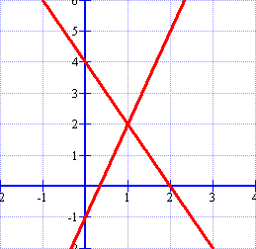
Intersecting Lines
The point where the lines intersect is your solution.
The solution of this graph is (1, 2)
(1,2)

Slide 25
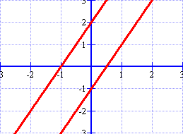
Parallel Lines
These lines never intersect!
Since the lines never cross, there is NO SOLUTION!
Parallel lines have the same slope with different y-intercepts.

Slide 26
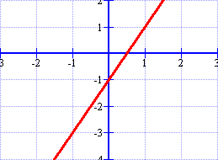
Coinciding Lines
These lines are the same!
Since the lines are on top of each other, there are INFINITELY MANY SOLUTIONS!
Coinciding lines have the same slope and y-intercepts.

Slide 27
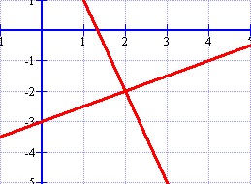
What is the solution of the system graphed below?
(2, -2)
(-2, 2)
No solution
Infinitely many solutions

Slide 28
1) Find the solution to the following system:
2x + y = 4
x - y = 2
Graph both equations. I will graph using x- and y-intercepts (plug in zeros).
Graph the ordered pairs.
2x + y = 4
(0, 4) and (2, 0)
x – y = 2
(0, -2) and (2, 0)

Slide 29
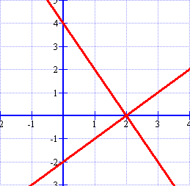
Graph the equations.
2x + y = 4
(0, 4) and (2, 0)
x - y = 2
(0, -2) and (2, 0)
Where do the lines intersect?
(2, 0)
2x + y = 4
x – y = 2

Slide 30
Check your answer!
To check your answer, plug the point back into both equations.
2x + y = 4
2(2) + (0) = 4
x - y = 2
(2) – (0) = 2
Nice job…let’s try another!

Slide 31
2) Find the solution to the following system:
y = 2x – 3
-2x + y = 1
Graph both equations. Put both equations in slope-intercept or standard form. I’ll do slope-intercept form on this one!
y = 2x – 3
y = 2x + 1
Graph using slope and y-intercept

Slide 32
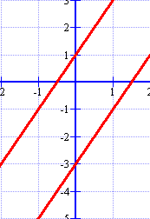
Graph the equations.
y = 2x – 3
m = 2 and b = -3
y = 2x + 1
m = 2 and b = 1
Where do the lines intersect?
No solution!
Notice that the slopes are the same with different y-intercepts. If you recognize this early, you don’t have to graph them!

Slide 33
What is the solution of this system?
3x – y = 8
2y = 6x -16
(3, 1)
(4, 4)
No solution
Infinitely many solutions

Slide 34
Solving a system of equations by Elimination.
Step 1: Put the equations in Standard Form.
Standard Form: Ax + By = C
Step 2: Determine which variable to eliminate.
Look for variables that have the
same coefficient.
Step 3: Multiply the equations and solve.
Solve for the variable.
Step 4: Plug back in to find the other variable.
Substitute the value of the variable
into the equation.
Step 5: Check your solution.
Substitute your ordered pair into
BOTH equations.

Slide 35
1) Solve the system using elimination.
2x + 2y = 6
3x – y = 5
Step 1: Put the equations in Standard Form.
They already are!
None of the coefficients are the same!
Find the least common multiple of each variable.
LCM = 6x, LCM = 2y
Which is easier to obtain?
2y (you only have to multiply the bottom equation by 2)
Step 2: Determine which variable to eliminate.

Slide 36
1) Solve the system using elimination.
2x + 2y = 6
3x – y = 5
Multiply the bottom equation by 2
2x + 2y = 6
(2)(3x – y = 5)
8x = 16
x = 2
2x + 2y = 6
(+) 6x – 2y = 10
Step 3: Multiply the equations and solve.
2(2) + 2y = 6
4 + 2y = 6
2y = 2
y = 1
Step 4: Plug back in to find the other variable.

Slide 37
1) Solve the system using elimination.
2x + 2y = 6
3x – y = 5
(2, 1)
2(2) + 2(1) = 6
3(2) - (1) = 5
Step 5: Check your solution.
Solving with multiplication adds one more step to the elimination process.

Slide 38
2) Solve the system using elimination.
x + 4y = 7
4x – 3y = 9
Step 1: Put the equations in Standard Form.
They already are!
Find the least common multiple of each variable.
LCM = 4x, LCM = 12y
Which is easier to obtain?
4x (you only have to multiply the top equation by -4 to make them inverses)
Step 2: Determine which variable to eliminate.

Slide 39
2) Solve the system using elimination.
x + 4y = 7
4x – 3y = 9
Multiply the top equation by -4
(-4)(x + 4y = 7)
4x – 3y = 9)
y = 1
Step 3: Multiply the equations and solve.
-4x – 16y = -28
(+) 4x – 3y = 9
-19y = -19
x + 4(1) = 7
x + 4 = 7
x = 3
Step 4: Plug back in to find the other variable.

Slide 40
2) Solve the system using elimination.
x + 4y = 7
4x – 3y = 9
(3, 1)
(3) + 4(1) = 7
4(3) - 3(1) = 9
Step 5: Check your solution.

Slide 41
Solving a system of equations by Substitution
Step 1: Solve an equation for one variable.
Pick the easier equation. The goal
is to get y= ; x= ; a= ; etc.
Step 2: Substitute
Put the equation solved in Step 1
into the other equation.
Step 3: Solve the equation.
Get the variable by itself.
Step 4: Plug back in to find the other variable.
Substitute the value of the variable
into the equation.
Step 5: Check your solution.
Substitute your ordered pair into
BOTH equations.

Slide 42
1) Solve the system using substitution
x + y = 5
y = 3 + x
Step 1: Solve an equation for one variable.
The second equation is
already solved for y!
Step 2: Substitute
x + y = 5 x + (3 + x) = 5
2x + 3 = 5
2x = 2
x = 1
Step 3: Solve the equation.

Slide 43
1) Solve the system using substitution
x + y = 5
y = 3 + x
x + y = 5
(1) + y = 5
y = 4
Step 4: Plug back in to find the other variable.
(1, 4)
(1) + (4) = 5
(4) = 3 + (1)
Step 5: Check your solution.
The solution is (1, 4). What do you think the answer would be if you graphed the two equations?

Slide 44
Which answer checks correctly?
3x – y = 4
x = 4y - 17
(2, 2)
(5, 3)
(3, 5)
(3, -5)

Slide 45
If you solved the first equation for x, what would be substituted into the bottom equation.
2x + 4y = 4
3x + 2y = 22
-4y + 4
-2y + 2
-2x + 4
-2y+ 22

