Slide 1
Linear Functions
Algebra 2 Concepts

Slide 2
A relation is a set of ordered pairs.
The domain is the set of all x values in the relation
domain = {-1,0,2,4,9}
These are the x values written in a set from smallest to largest
This is a relation
{(2,3), (-1,5), (4,-2), (9,9),
{(2,3), (-1,5), (4,-2), (9,9),
{(2,3), (-1,5), (4,-2), (9,9), (0,-6)}
These are the y values written in a set from smallest to largest
range = {-6,-2,3,5,9}
The range is the set of all y values in the relation

Slide 3
A function f from set A to set B is a rule of correspondence that assigns to each element x in the set A exactly one element y in the set B.
1
2
All x’s are assigned
2
4
3
6
4
8
5
10
Set A is the domain
Set B is the range
This is a function ---it meets our conditions
Must use all the x’s
The x value can only be assigned to one y

Slide 4
Let’s look at another relation and decide if it is a function.
The second condition says each x can have only one y, but it CAN be the same y as another x gets assigned to.
No x has more than one y assigned
1
2
All x’s are assigned
2
4
3
6
4
8
5
10
Set A is the domain
Set B is the range
This is a function ---it meets our conditions
Must use all the x’s
The x value can only be assigned to one y

Slide 5
If a vertical line passes through a graph more than once, the graph is not the graph of a function.
Hint:
Pass a pencil across the graph held vertically to represent a vertical line.
The pencil crosses the graph more than once. This is not a function because there are two y-values for the same x-value.

Slide 11
Function Notation
We commonly call functions by letters. Because function starts with f, it is a commonly used letter to refer to functions.
This means the right hand side is a function called f
The left side DOES NOT MEAN f times x like brackets usually do, it simply tells us what is on the right hand side.
This means the right hand side has the variable x in it
The left hand side of this equation is the function notation. It tells us two things. We called the function f and the variable in the function is x.

Slide 12
Remember---this tells you what is on the right hand side---it is not something you work. It says that the right hand side is the function f and it has x in it.
So we have a function called f that has the variable x in it.
Using function notation we could then ask the following:
This means to find the function f and instead of having an x in it, put a 2 in it. So let’s take the function above and make brackets everywhere the x was and in its place, put in a 2.
Find f (2).
Don’t forget order of operations---powers, then multiplication, finally addition & subtraction

Slide 13
Find f (2k).
This means to find the function f and instead of having an x in it, put a 2k in it. So let’s take the function above and make brackets everywhere the x was and in its place, put in a 2k.
Don’t forget order of operations---powers, then multiplication, finally addition & subtraction

Slide 14
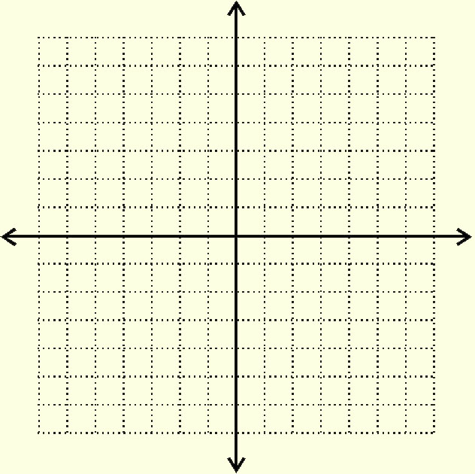
Graphing Linear Equations

Slide 15
These equations are all in Slope-Intercept Form:
Notice that these equations are all solved for y.

Slide 16
Just by looking at an equation in this form, we can draw the line (no tables).
The constant is the y-intercept.
The coefficient is the slope.
Constant = 1, y-intercept = 1.
Coefficient = 2, slope = 2.
Constant = -4, y-intercept = -4.
Coefficient = -1, slope = -1.
y-intercept = -2
slope = 3/2.

Slide 17
Remember the Slope Formula!

Slide 18
The formula for Slope-Intercept Form is:
‘b’ is the y-intercept.
‘m’ is the slope.
On the next three slides we will graph the three equations:
using their y-intercepts and slopes.

Slide 19
1) Plot the y-intercept as a point on the y-axis. The constant, b = 1, so the y-intercept = 1.
right 1
right 1
up 2
up 2
2) Plot more points by counting the slope up the numerator (down if negative) and right the denominator. The coefficient, m = 2, so the slope = 2/1.

Slide 20
1) Plot the y-intercept as a point on the y-axis. The constant, b = -4, so the y-intercept = -4.
2) Plot more points by counting the slope up the numerator (down if negative) and right the denominator. The coefficient, m = -1, so the slope = -1/1.
down 1
down 1
right 1
right 1

Slide 21
1) Plot the y-intercept as a point on the y-axis. The constant, b = -2, so the y-intercept = -2.
right 2
up 3
right 2
up 3
2) Plot more points by counting the slope up the numerator (down if negative) and right the denominator. The coefficient, m = 3/2, so the slope = 3/2.

Slide 22
Sometimes we must solve the equation for y before we can graph it.
The constant, b = 3 is the y-intercept.
The coefficient, m = -2 is the slope.

Slide 23
1) Plot the y-intercept as a point on the y-axis. The constant, b = 3, so the y-intercept = 3.
down 2
2) Plot more points by counting the slope up the numerator (down if negative) and right the denominator. The coefficient, m = -2, so the slope = -2/1.
right 1
down 2
right 1

Slide 24
These equations are all in Slope-Intercept Form:
Notice that these equations are all solved for y.

Slide 25
Just by looking at an equation in this form, we can draw the line (no tables).
The constant is the y-intercept.
The coefficient is the slope.
Constant = 1, y-intercept = 1.
Coefficient = 2, slope = 2.
Constant = -4, y-intercept = -4.
Coefficient = -1, slope = -1.
y-intercept = -2
slope = 3/2.

Slide 26
The formula for Slope-Intercept Form is:
‘b’ is the y-intercept.
‘m’ is the slope.
On the next three slides we will graph the three equations:
using their y-intercepts and slopes.

Slide 27
1) Plot the y-intercept as a point on the y-axis. The constant, b = 1, so the y-intercept = 1.
right 1
right 1
up 2
up 2
2) Plot more points by counting the slope up the numerator (down if negative) and right the denominator. The coefficient, m = 2, so the slope = 2/1.

Slide 28
1) Plot the y-intercept as a point on the y-axis. The constant, b = -4, so the y-intercept = -4.
2) Plot more points by counting the slope up the numerator (down if negative) and right the denominator. The coefficient, m = -1, so the slope = -1/1.
down 1
down 1
right 1
right 1

Slide 29
1) Plot the y-intercept as a point on the y-axis. The constant, b = -2, so the y-intercept = -2.
right 2
up 3
right 2
up 3
2) Plot more points by counting the slope up the numerator (down if negative) and right the denominator. The coefficient, m = 3/2, so the slope = 3/2.

Slide 30
Sometimes we must solve the equation for y before we can graph it.
The constant, b = 3 is the y-intercept.
The coefficient, m = -2 is the slope.

Slide 31
1) Plot the y-intercept as a point on the y-axis. The constant, b = 3, so the y-intercept = 3.
down 2
2) Plot more points by counting the slope up the numerator (down if negative) and right the denominator. The coefficient, m = -2, so the slope = -2/1.
right 1
down 2
right 1

