Slide 1
Whole Numbers and Integers

Slide 2
What will we learn today?
~ The difference between prime and composite numbers
~ The factors of composite numbers
~ How to find the prime factorization of a number
~How to find the greatest common factor and least common multiple of a number

Slide 3
Prime Vs. Composite
Prime Number: a number that has exactly two factors , 1 and itself
Examples:17 and 19
Composite Number: a number that has three or more factors
Examples: 4 and 6
Factors: numbers multiplied to get a product

Slide 4
Example 1)
Determine if the number is prime or composite. If the number is composite, list all of the factors.
a) 25
b) 29
c) 27
d) 31

Slide 5
Try this...
Is there a formula to find all of the prime numbers? Estimate how many prime numbers are between 1 and 50. Then, list the numbers and count how many are prime.

Slide 6
Finding the Factors of a Number
Helpful Hints:
Divisible by | If...
2 | Last digit is even
3 | Sum of digits is divisible by 3
4 | Last 2 digits are divisible by 4
5 | Ends in 0 or 5
6 | Divisible by both 2 and 3.
7 | Double the last digit and subtract from the number formed by deleting the last digit. Repeat until its easy to determine if its divisible by 7. If so, then yes.
8 | Last three digits are divisible by 8
9 | Sum of digits is divisible by 9
10 | Last digit is 0
11 | Alternate the signs of the digits and add. If the sum is divisible by 11 so is the original number.

Slide 7
Prime Factorization
~ Rewriting a number as the product of prime numbers
Example: Prime factorization of 12 is...
~ Two methods to find the prime factorization:
Tree Method
Division Method

Slide 8
Example 2)
Find the prime factorization of 100 using the tree method.
Example 3)
Find the prime factorization of 90 using the division method.

Slide 9
Try this...
Find the prime factorization of 360 using either method.

Slide 10
Greatest Common Factor
~ The largest number that is the factor of both numbers being considered (GCF)
Example:
18 and 24
~Don't forget the prime factorization!!
72:
180:

Slide 11
Least Common Multiple
~The smallest number that is a multiple of each number (LCM)
~ Prime factorization helps here too!
Example:
24, 30, and 42

Slide 12
Applying to the Real World
1) An enterprising student buys unsold bags of Halloween candy for resale. If he has 360 "fun size" bags of peanut M&M's and 420 bags of plain M&M's, how should he package them so that there is only one type of M&M in each bag and every bag has the same number of bags?
2) After getting out of college, Colleen vows to buy herself a new item of clothing every 15 days, and a new pair of shoes every 18 days just because she can. How long will it be until she buys both items on the same day?

Slide 13
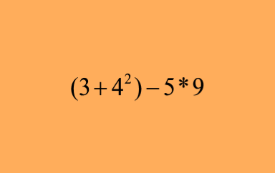
Last But Not Least!
Don't forget your order of operations!!!!

Slide 14
Relay Time!

